Slide 1
Metrics in Education (in informatics)
Ivan Pribela, (Zoran Budimac)

Slide 2
Content
Motivation
Areas of application
Used metrics
Proposed metrics
Conclusions

Slide 3
Motivation (educational)
Designing and coding computer programs is a must-have competence
Needed in academic training and future labour
Requires a learning by doing approach
Giving the students enough information about what they are doing right and wrong while solving the problems is essential for better knowledge acquisition
This will allow the students to better understand their faults and to try to correct them
Industry standard metrics are not always understood
Values of the metrics are not saying much
There is a need for human understandable explanation of the values
New metrics more approachable by students in some cases

Slide 4
Motivation (“cataloguing”)
Making a “catalogue” of metrics in different fields:
Software
(software) networks
educational software metrics
ontologies
… and possibly finding relations (and / or new uses) between them

Slide 5
Areas of Application
Assignment difficulty measurement
Student work assessment
Plagiarism detection
Student portfolio generation

Slide 6
1. Assignment difficulty measurement
Done on a model solution
Better quality solution
Less complex code
Different measures for reading and writing
Measure quality level not just the structure
Level of thinking required and cognitive load
Three difficulty categories
Readability
Understandability (complexity + simplicity + structuredness + readability)
Writeability

Slide 7
Metrics used
Fathom based on Flesch-Kincaid readability measure
No justification or explanation for weightings and thresholds
Software Readability Ease Score
No details for the calculation
Halstead’s difficulty measure
Obvious, but no thresholds
McCabe’s cyclomatic complexity
Strongly correlate, but no thresholds
Average block depth
Obvious, but no thresholds
Magel’s regular expression metric
Strongly correlate, but no thresholds

Slide 8
Metrics used
Sum of all operators in the executed statements
Dynamic measure, only relevant for readability
Number of commands in the executed statements
Dynamic measure, only relevant for readability
Total number of commands
Strongly correlates
Total number of operators
Strongly correlates
Number of unique operators
Weakly correlates

Slide 9
Metrics used
Total number of lines of code (excluding comments and empty lines)
Strong correlation
Number of flow-of-control constructs
Strong correlation
Number of function definitions
Some correlation
Number of variables
Weak correlation

Slide 10
Fathom
(Starsinic, 1998)
Code Complexity
CC = (average expression length in tokens) * 0.55 + (average statement length in expressions) * 0.28 + (average subroutine length in statements) * 0.08
Very readable
<2.91
Very complex and hard to read
>6.85
Values are emprical

Slide 11
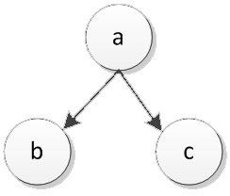
Magel’s regular expression metric
(Magel, 1981)
Expression
a (b+c)
Metric value
6

Slide 12
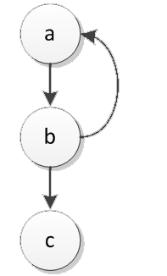
Magel’s regular expression metric
(Magel, 1981)
Expression
ab (ab)* c
Metric value
8

Slide 13
2. Student work assessment
Three main goals for measurement
Diagnostic assessment
Measurement of the performance of a cohort of students in order to identify any individual learning difficulties, common problems, and areas of strength
Formative assessment
Provides feedback directly to students with the goal of helping them to improve their understanding of the subject
Summative assessment
Measures how well students have achieved learning objectives

Slide 14
Metrics used
McCabe’s cyclomatic complexity
(Edwards, 2014)
(Jurado, Redondo, Ortega, 2012)
(Pribela, Rakic, Budimac, 2012)
(Cardell-Oliver, 2011)
(Breuker, Derriks, Brunekreef, 2011)
(Mengel, Yerramilli, 1999)
(Joy, Luck, 1999)
(Jackson, Usher, 1997)
(Thorburn, Rowe, 1997)
(Jackson, 1996)
(Leach, 1995)

Slide 15
Metrics used
Berry-Meekings style guides / style violation
(Edwards, 2014)
(Pribela, Rakic, Budimac, 2012)
(Cardell-Oliver, 2011)
(Joy, Griffiths, Boyatt, 2005)
(Truong, Roe, Bancroft, 2004)
(Jackson, 2000)
(Mengel, Yerramilli, 1999)
(Joy, Luck, 1998)
(Jackson, Usher, 1997)
(Thorburn, Rowe, 1997)
(Jackson, 1996)

Slide 16
Metrics used
Halstead’s complexity measures
(Mengel, Yerramilli, 1999)
(Joy, Luck, 1999)
(Leach, 1995)
Coupling / Cohesion / Modularisation
(Jackson, 2000)
(Joy, Luck, 1998)
(Leach, 1995)
Scope number
(Joy, Luck, 1999)

Slide 17
Metrics used
Lines of code w/o comments & empty lines
(Edwards, 2014)
(Jurado, Redondo, Ortega, 2012)
(Pribela, Rakic, Budimac, 2012)
(Cardell-Oliver, 2011)
(Breuker, Derriks, Brunekreef, 2011)
(Benford, Burke, Foxley, Higgins 1995)
Number of classes/methods/fields
(Edwards, 2014)
(Cardell-Oliver, 2011)
(Breuker, Derriks, Brunekreef, 2011)
(Joy, Griffiths, Boyatt, 2005)

Slide 18
Metrics used
Custom
(Jurado, Redondo, Ortega, 2012)
(Breuker, Derriks, Brunekreef, 2011)
(Benford, Burke, Foxley, Higgins, 1995)
Algorithm parameterization
Number of blocks/arrays/variables
Number of method calls/recursive calls
Operational complexity/control complexity
Number of value/reference parameters

Slide 19
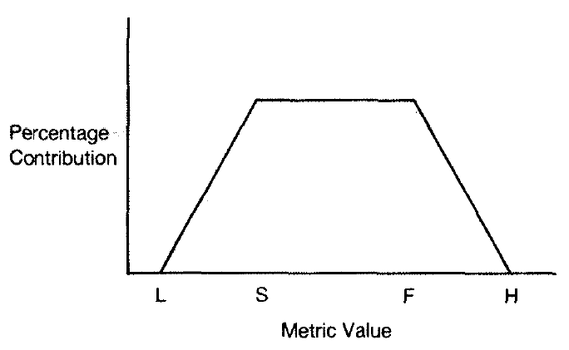
Berry-Meekings style guidelines
(Berry, Meekings, 1985)
Metric Boundary Values
Cntr. L - S - F - H
Module length 15% 4-10-25-35
Identifier length 14% 4-5-10-14
Comment lines 12% 8-15-25-35
Indentation 12% 8-24-48-60
Blank lines 11% 8-15-30-35
Characters per line 9% 8-12-25-30
Spaces per line 8% 1-4-10-12
Defines 8% 10-15-25-30
Reserved words 6% 4-16-30-36
Include files 5% 0-3-3-4
Gotos -20% 1-3-99-99

Slide 20
3. Plagiarism detection
Types of detection
Attribute counting systems
Different systems use different features in calculations
Better for smaller alteration
Structure metric
Use string matching on source or token streams
Better at detection of sophisticated hiding techniques
Hybrid
Mix of both approaches

Slide 21
Levels of plagiarism
Verbatim copying
Changing comments
Changing whitespace and formatting
Renaming identifiers
Reordering code blocks
Reordering statements within code blocks
Changing the order of operands/operators in expressions
Changing data types
Adding redundant statements or variables
Replacing control structures with equivalent structures

Slide 22
Metrics used
Number of lines/words/characters
(Stephens, 2001), (Jones, 2001), (Jones, 2001)
...
We are using our “universal” eCST representation for “many” programming languages that could us lead to detect plagiarism between (e.g.) Java and Erlang

Slide 23
4. Student portfolio generation
Collection of all significant work completed
Major coursework
Independent studies
Senior projects
Critical in many areas of the arts
Typically used during the interview process
To show the artistic style and capabilities of the candidate
To observe own progression in terms of depth and capability
In computer science
Software quality metrics applied to student portfolio submissions
Maximizes the comparative evaluation of portfolio components
Provides a quantifiable evaluation of submitted elements

Slide 24
Student portfolio generation
Should include exemplars of all significant work produced
Students select which items are included
Public portfolios distinct from internal portfolios
Open to inspection by the student and the department
A number of commonly used software quality metrics exists
Too coarse for sufficient student feedback
Requirements for pedagogically-oriented software metric

Slide 25
Conclusion
Not as bad as it first seemed
Various standard metrics are used
Some new have been devised
Some metrics are still needed

